Slide 1
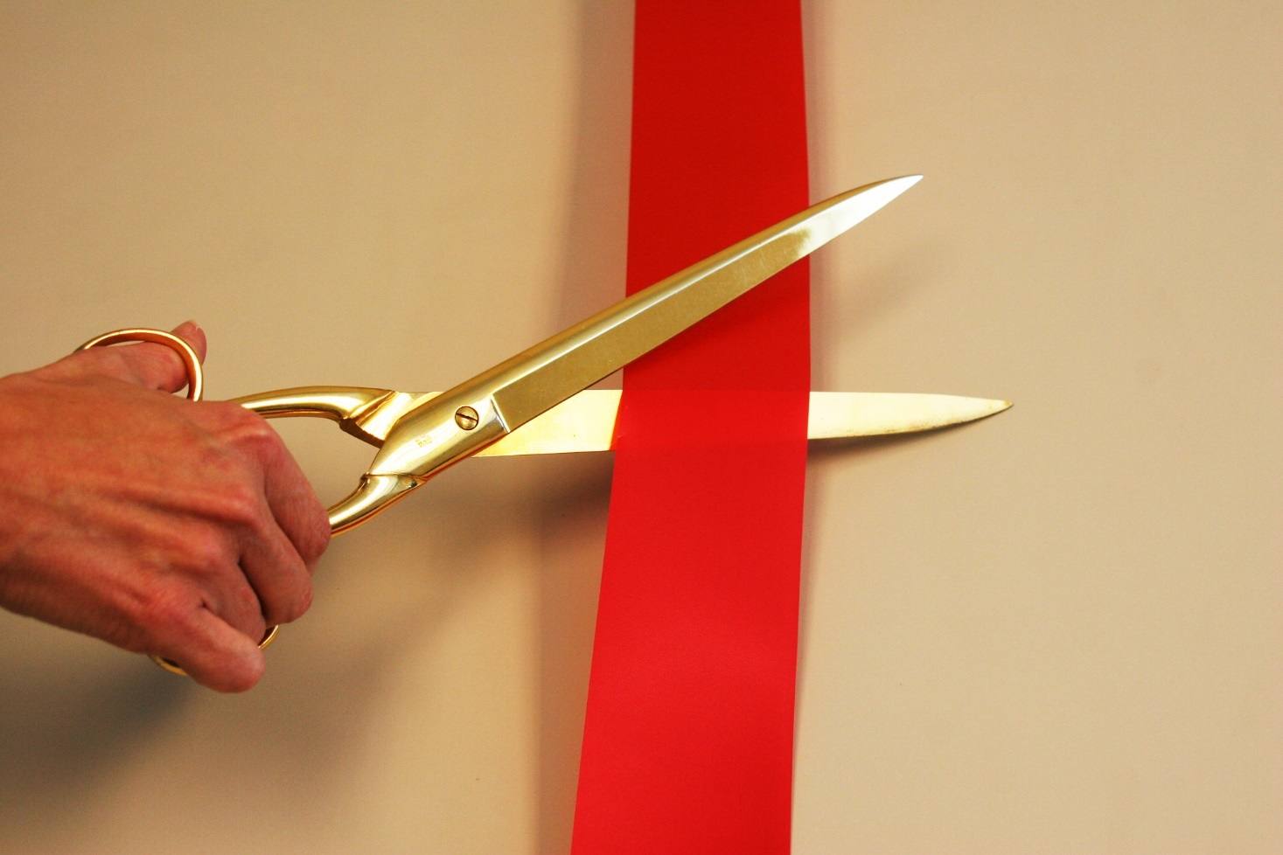
Launching the community-run Journal of Open Hardware
22nd March 2017, Santiago, Chile

Slide 2
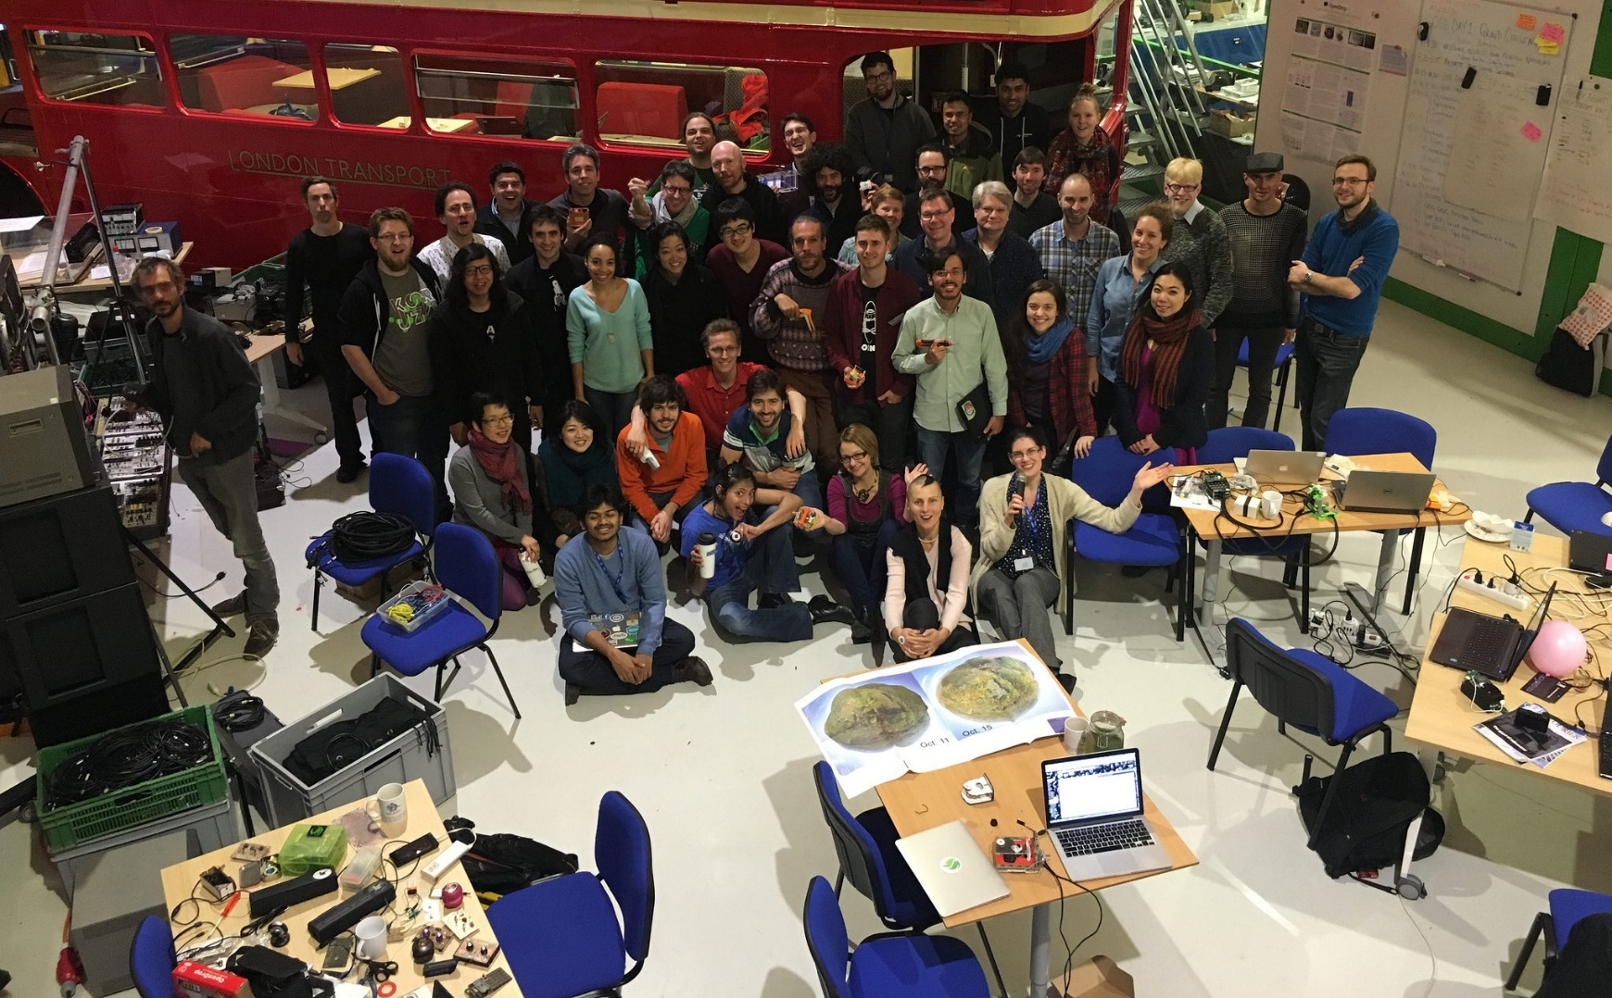
Everything started at GOSH‘16

Slide 3

Why would we need yet another academic journal?
Dedicated format for truly open hardware
Peer-review and preservation of documentation
Joint forum for academics, community members, and hardware professionals
Exchange where impact lies: science, engineering, humanities, law, economics, sociology, design, etc.
Community control over accessibility, values, content, pricing, and development goals, in fair partnership with

Slide 4
Hardware Metapapers
Arduino-like development kit for single-element ultrasound imaging
Luc Jonveaux ¹
An open-source software ecosystem for ultrasound imaging is widely available to developers, however, limited resources can be found on the open-hardware side. The focus of this work was to develop an easy-to-use platform kit (hardware and software) for providing the community a complete experimental setup for ultrasound imaging at a low cost, without the need for expensive and non-modifiable specific equipment. The goal of this work resembles the needs of medical systems in the 80's where analog techniques using single-sensor devices were prominent. To this end, two open-source, arduino-like modules have been developed for building a simple, yet complete, single-channel analog front-end system, where all the intermediary signals are readily accessible by the user. A single-channel architecture avoids the beamforming overhead, though it limits the quality of the captured image, and brings simplicity to the system. The modules were tested using re-purposed ultrasound mechanical probes, as well as non-medical transducers. Furthermore, different digital acquisition systems were utilized for providing the images of interest. The developed modules can also be used in Radio Frequency (RF) projects, non-destructive testing and control projects, as well as in low-cost medical imaging projects on non-living samples.
(1) independent maker

Slide 5
Articles: Issues in open science hardware
Emerging Business Models for Open Source Hardware
Joshua M. Pearce ¹
The rise of Free and Open Source models for software development has catalyzed the growth of Free and Open Source hardware (also known as “Libre Hardware”). Libre hardware is gaining significant traction in the scientific hardware community, where there is evidence that open development creates both technically superior and far less expensive scientific equipment than proprietary models. In this article, the evidence is reviewed and a collection of examples of business models is developed to service scientists who have the option to manufacture their own equipment using Open Source designs. Profitable Libre Hardware business models are reviewed, which includes kit, specialty component, and calibration suppliers for makers. The results indicate that Libre Hardware businesses should target technically sophisticated customers first and, as usability matures, target expanded markets of conventional consumers.
.
(1) Michigan Technological University

Slide 6
Reviews
Gathering for Open Science Hardware
Shannon Dosemagen¹, Max Liboiron² and Jenny Molloy³
Without hardware, there is no science. Instruments, reagents, computers, and lab equipment are the platforms for producing systematic knowledge. Yet, current supply chains limit access and impede creativity and customization through high mark-ups and proprietary designs. This can be compounded by private hardware licenses and patents. Open Science Hardware (OSH) addresses part of this problem by sharing designs, instructions for building, and protocols . Expanding the reach of Open Science Hardware within academic research, NGO initiatives, citizen science, and education has potential to increase access to experimental tools and facilitate their customization and reuse while lowering costs. A growing number of people and organizations around the world are developing and using Open Science Hardware, but a coherent, self-organizing community has yet to emerge that could raise its profile and drive required social change within institutions, laws, and common practice that would make open science with open hardware the norm. The Gathering for Open Science Hardware (GOSH) in 2016 addressed this need. It brought together 50 of the most active developers, users, and thinkers in the Open Science Hardware (OSH) movement, complemented by expertise from diverse backgrounds, to seed a global community . GOSH now continues as an online community with a further meeting planned in Santiago, Chile, in 2017.
(1) Public Lab; (2) Civic Laboratory for Environmental Action Research; (3) University of Cambridge

Slide 7
Call for submission
>> journal of open hardware.org
Hardware metapapers + documentations
Articles: Issues in open science hardware
Reviews
Special GOSH 2017 edition
Join us build the Journal of Open Hardware!
Submit an article about your work or your discussions at GOSH by the 28th of May, 2017.

Slide 8

Editorial team
Tobias Wenzel*, Luis Felipe R. Murillo*, Richard Bowman*, Ivana Gadjanski*, Luka Mustafa*, Pieter van Boheemen, Ward Hills*, Pietari Kauttu*, Jenny Molloy*, François Grey*, Jim Haseloff, Rafael Peretti Pezzi*, Mitch Altman, Alicia Gibb, Fernán Federici Noe*,
Joshua Pearce, Max Liboiron*, William Liang, Tim Rudge*, André Maia Chagas*, Tom Baden*, Primavera De Filippi, Limor "ladyada" Fried, Andrew Katz, Nadya Peek, Andrew Pelling*, Harri Toivonen*, Phillip Torrone, You?*
*Present at GOSH(s); Here today

